Slide 1


Slide 2
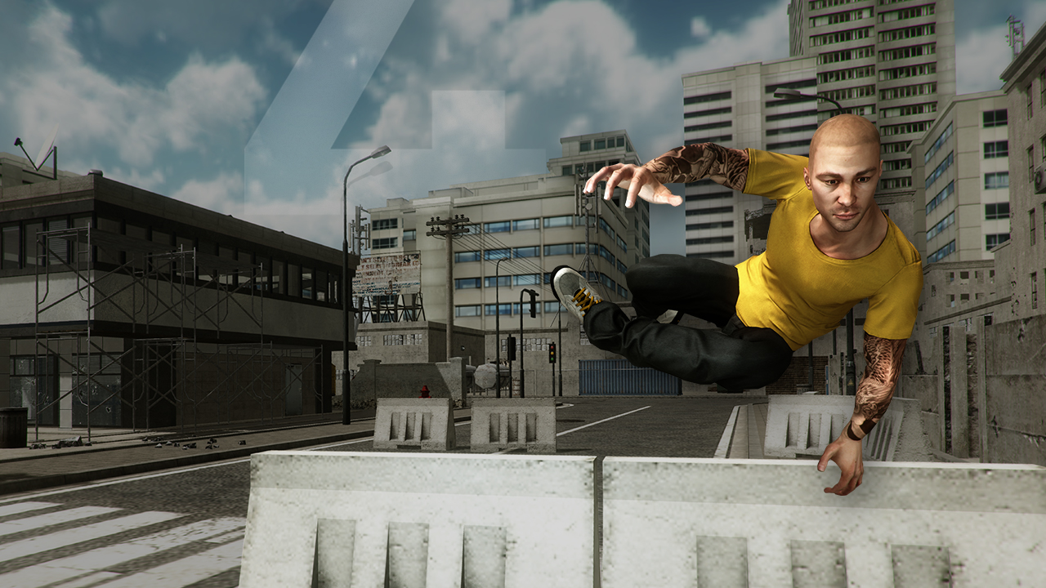
Table of Contents
^{What is Unity?}
^{Asset Store}
^{Lighting & Rendering}
^{Performance}
^{Scripting}
^{Efficient Workflow}
^{Mecanim}
^{Pathfinding}
^{Effects}
^{Union}

Slide 3
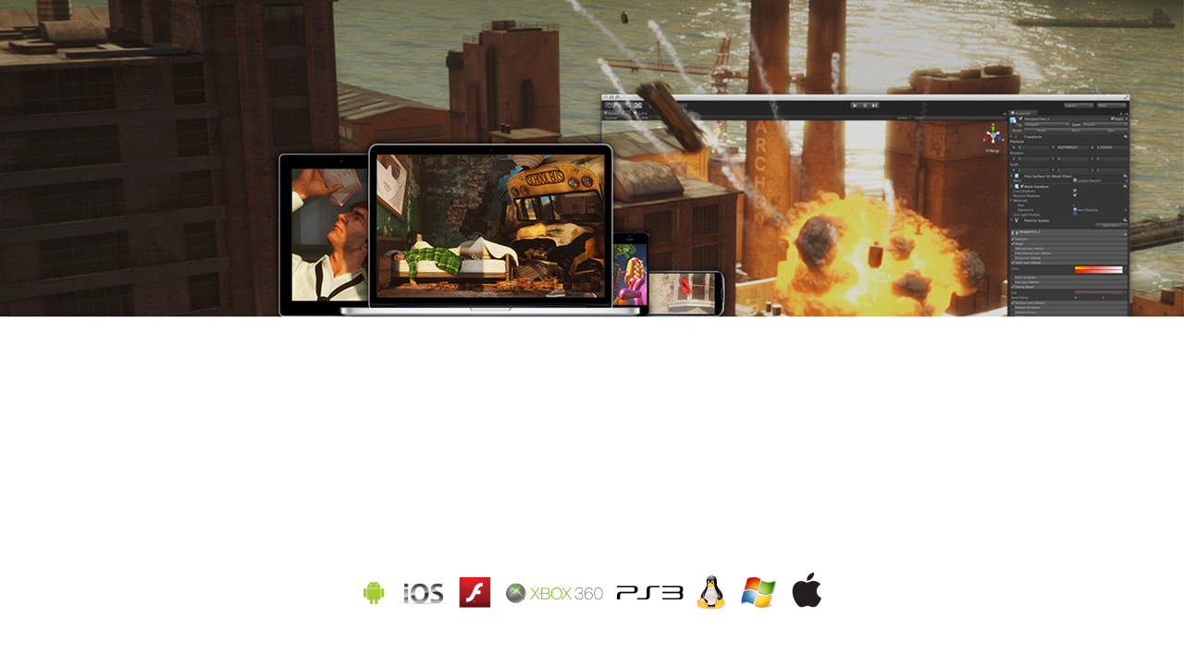
What is Unity?
Over 1,000,000 people use Unity to develop original, professional and complex games and 3D content. Whether you’re an indie dude with a dream, or a major studio mapping out your next hit, Unity provides you with all the core functionality you need, right out of the box. With astonishing speed and efficiency, you can assemble your game from art and assets, pack it with action and special effects, and publish your final work to Mac, PC, and Linux desktop computers—as well as the Web, iOS, Android, home gaming consoles and even Adobe Flash.
Download Unity for free at www.unity3d.com and get set to create, publish and sell your game for any platform.

Slide 4

Asset Store
^{Accelerate Your Development}
The Asset Store is the fastest way to take your game from concept to reality. Conveniently built directly into Unity 4’s new Project Window,
the Asset Store has all the free and for-sale resources you need to help assemble your game. All of your development needs covered: artwork, scripts, visual programming solutions, Mecanim character animation assets, and superb editor extensions – such as graphical shading editors – are all available for download.
^{Become an Expert} ^{- for Free!}
The Asset Store is loaded with free resources to help you up your game. Demos, such as AngryBots, BootCamp, and Allegorithmic Substances show you some of the technical and graphical feats possible with Unity. Video tutorials will help you master car physics, character customizations, C#, tree creation and so much more.
^{Sell in the Store}
Whether you’re a programmer, game designer, texture artist or 3D modeler, the Unity Asset Store is a great place to share and sell your creations. If we select your submission, it will become available on the Asset Store and you’ll receive a 70% cut of each sale.

Slide 5
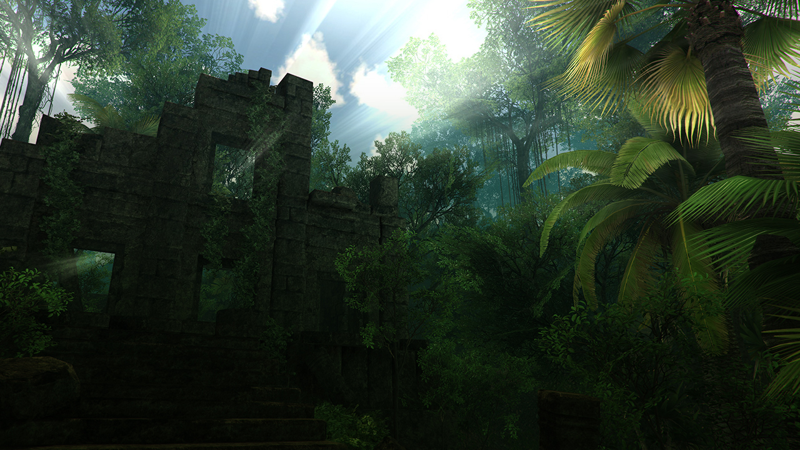
Lighting & Rendering
^{Gorgeous Lighting}
Unity ships with lighting options that will make your game look like real life – or better! Make stunning visuals with linear space (gamma correct) lighting and HDR rendering; achieve unprecedented realism with directional lightmaps or emissive lights for luminous neon signage; cast any shadow you want, and choose from a wealth of built-in shaders. Set up any number of distinct lights in your scenes, and Unity’s deferred rendering will make sure your game looks great and performs beautifully.
^{Great Performance}
Unity’s integrated lightmapping tool, Beast, perfectly bakes lights into textures for amazing performance. Baking both direct and indirect bounced light allows for realistic and beautiful lighting that would otherwise be impossible in realtime. Unity’s lightmapping enables you to seamlessly blend dynamic and baked lights so even vast scenes perform fast, while light probes add life and realism without the high cost of typical dynamic lights.
^{Iterative Lightmap Baking}
Unity 4’s iterative lightmap baking gives you complete control of your lightmapping workflow. With the option to “bake selected”, you spend time baking only the parts of the scene you’re actively working on. Coupled with new updates – the use of normal maps when lightmapping, and lower memory requirements for the bake process – it has never been faster or easier to add detail and nuance to your lightmapped scenes. Unity 4 fully supports Microsoft’s DirectX 11, and even brings self-shadowing real-time shadows to mobile devices.

Slide 6
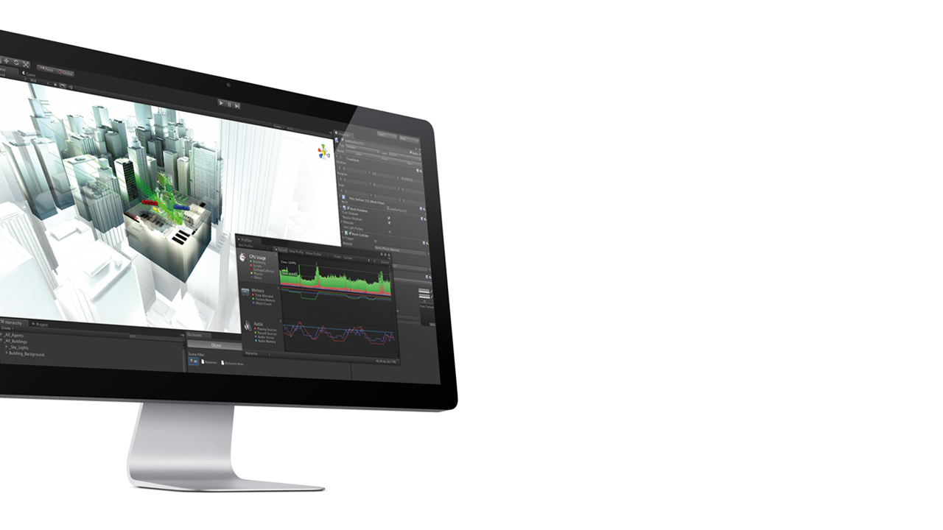
Performance
^{Smooth Predictable Performance}
Unity 4’s Profiler now reports on GPU usage for games running on Android devices with Tegra chipsets, so you can zero in on and adjust performance bottlenecks for gameplay on the move. The Unity Profiler reports how much time is spent in the various areas of your game. Play your game in the Editor with Profiling on, and capture performance data for CPU and GPU in real time.
^{Skinned Meshed Instancing}
Unity 4 lets you efficiently create your own crowd rendering system by providing script access to the output from a skinned mesh renderer. Pre-compute animated poses, or cheaply render multiple instances of a mesh in the same pose.
^{Full DirectX 11 Support}
Unity 4 support Microsoft’s DirectX 11, and thus the ability to take advantage of the GPU in new and exciting ways: increased shader capabilities with shader model 5, tessellation for smoother models and environments in game worlds, and compute shaders for advanced GPU computation.

Slide 7
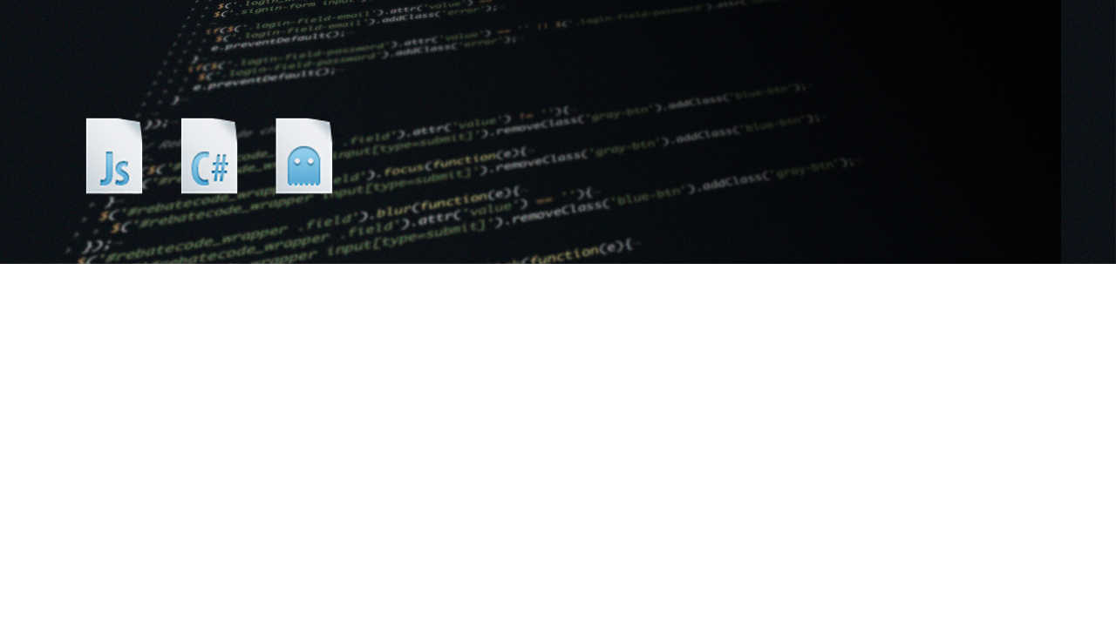
Scripting
^{Flexible Scripting}
Unity supports three scripting languages: Java-Script, C# and a dialect of Python named Boo. All three run on the Open Source .NET platform, Mono, and are compiled to native code to run nearly as fast as C++. You benefit from fast iteration, fast execution and the full strength and flexibility of one of the world’s leading programming environments.
^{Easy Debugging}
Unity provides fully-integrated script debugging with MonoDevelop for both Windows and Mac. You can pause your game, do single step line by line, set breakpoints and inspect values.

Slide 8

Efficient Workflow
Unmatched Speed and Organized Asset Management
The Unity Asset Pipeline is unmatched for its seamless importing and breadth of support. All assets are automatically imported upon save, and ready to work with in the Unity Editor. Unity can import 3D models, bones and animations from almost any 3D application.
Textures and scripts are handled efficiently. Unity imports any audio format that is supported by FMOD, and can convert and distribute it as Ogg Vorbis to improve overall game performance.
New Project Window workflows in Unity 4 allow for fast asset search and management. Users can also search, live preview and purchase assets from the Asset Store in the main Project Window. New component-based workflow lets you add components to objects via a handy new drop-down button. New copy/paste functionality makes it a breeze to move components between game objects, or retrieve your tweaks and edits back from Play mode. You can even rearrange your image effects by simply moving components up or down the stack to quickly achieve the effect you want.
Native Support for Allegorithmic Substances
With Unity, you can load Allegorithmic Substance files straight into your project, and tweak and adjust their parameters inside the Unity Editor.

Slide 9
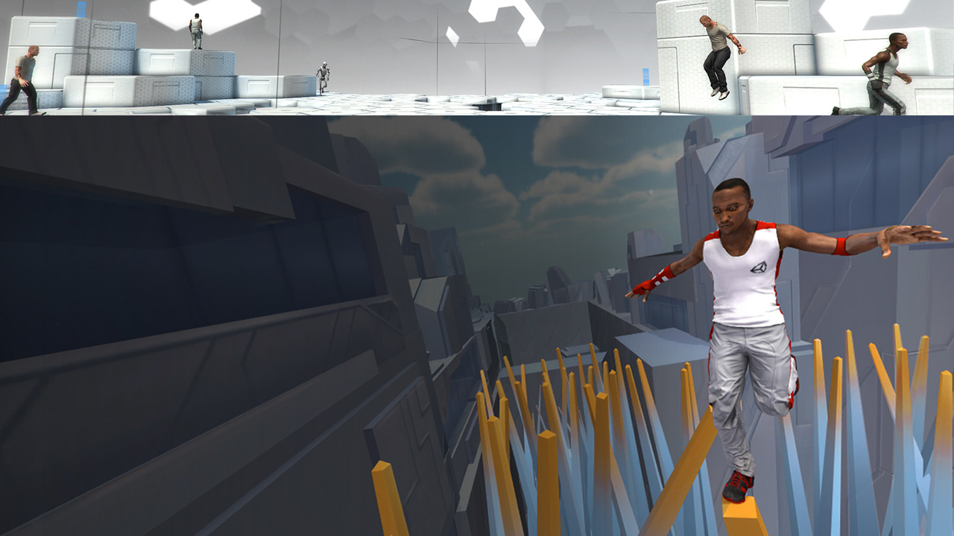
Mecanim
Character Animation Transformation
Mecanim is Unity’s uniquely powerful and flexible character animation system, bringing your humanoid characters to life with incredibly fluid and natural motion.
Once you set up your rigged models in Unity, advanced retargeting makes it possible to use and re-use animations across a wide variety of character physiques. Import animation and motion capture data from your favorite tool – or from the Asset Store – and your characters will move fluidly while using extremely few CPU cycles.
Define and refine your animations using Unity’s visual tools. Easily construct and edit complex state machines and blend trees for complete control over how your characters move. Need to animate vast armies? Not only is character setup precise and efficient, but Mecanim’s stability and power – combined with new optimizations, such as skinned mesh instancing – ensure smooth runtime performance.

Slide 10
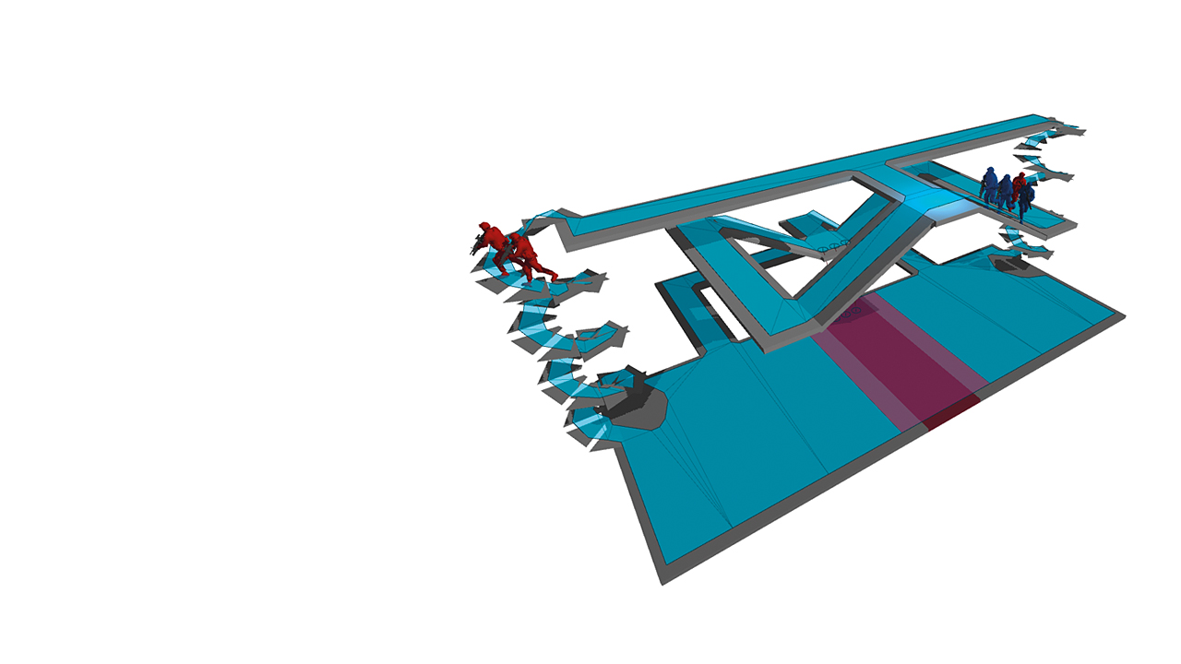
Pathfinding
^{Optimized Path-Finding}
Unity helps you quickly bring your scene to life with automatic navigation mesh (NavMesh) generation. NavMeshes describe the boundaries of any navigable space in your game and are used at runtime for path-finding. In Unity 3.5, you can now bake your navigation data in the editor, and let Unity’s high-performance path-finding and crowd simulation take over at runtime.

Slide 11

Effects
Take Your Game from Good to Gorgeous
Unity provides full-screen post-processing effects that transform your game into a refined, high- polish finished product. Bloom and lens flares drastically enhance the look of your scene; sun shafts create radial light scattering, such as god rays or light beams; and Depth of Field effects add a defocused foreground or background.
Perfect Control Over Complex Effects
Hurricanes, fireworks, explosions, clouds of smoke and fire – Unity gives you complete control to craft spectacular special effects with our Shuriken Particle System. Shuriken is a curve and gradient-driven modular particle system tool that allows you to easily adjust individual parameters or each particle system via a Curve Editor. New to Unity 4, Shuriken supports external forces, bent normals, and automatic culling.

Slide 12

^{A True and Valuable Ally}
Union is a groundbreaking service that helps Unity developers bring games to new markets, reach new platforms and earn more money. A unique service for ambitious developers, Union combines access to diverse platforms, highly competitive fees and outstanding support on all levels.
^{Union for Developers}
Union ports Unity-authored titles to new and emerging platforms. We license games and then distribute them to new markets to earn extra money for developers. The best part? There’s no cost to join Union – we’re here to help get your games on new platforms!
^{Union for Manufacturers}
Union’s game catalogue is constantly expanding, and includes a wide variety of quality Unity-authored content. The catalogue features numerous genres – from shooters and racing games to puzzle games and action-adventure! It also has games that can monetize in a variety of ways, from subscription to premium download or in-app purchases.

Slide 13
